Slide 1

Drupal Modules
Notes:
Hey everyone!
Today we’re going to talk about ChickTech. First of all, let’s talk about our name. CHICKtech. Yes, we’re using the word Chick in a positive context. Some people have voiced concerned over our name choice. We are reclaiming the word Chick, and we’re using it in a positive way. We are strong, powerful, confident, awesome CHICKS.
You can follow us on twitter, or check out our work-in-progress website chicktech.org. On there we have at least one mailing list that you can join.
<janice> I am the founder of ChickTech … <Janice’s short bio>
<jen> I’m a volunteer with ChickTech. I’m helping to organize workshops, reaching out to the Portland community for sponsorships and connections, and helping with the web presence. This is something I do in my spare time. As you may have heard on Wednesday, I’m also the community manager for Privly. And I’m a PhD graduate student in computer science at Oregon State University doing research around open source software. If you want to hear more about that, come to <this talk> later today.
Ok, now you know a bit about us. So let’s get going.

Slide 2


Technical Definition
Software (usually PHP and CSS) that extends Drupal features and functionality. Drupal distinguishes between “core” and “contributed” modules.

Slide 3
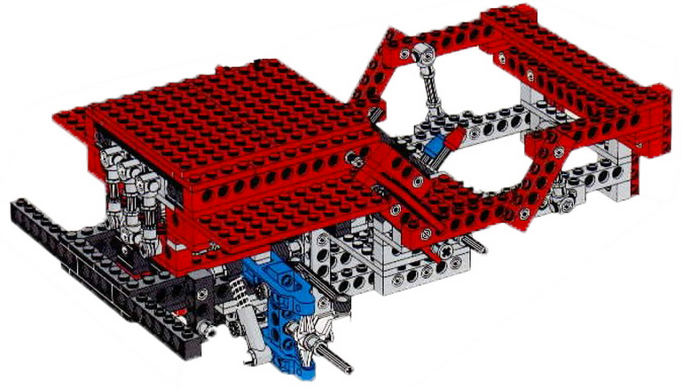
Drupal Core
The frame. The engine runs, but you wouldn't call it finished vehicle on its own. Most of "Drupal Core" is actually a bunch of modules.
Notes:
So what are we actually DOING?
We’re in the process of organizing an event for the end of Janaury.
We’ll give 9 high schools, 10 tickets each to give to interested high school girls. 10 tickets will be reserved for alternatively educated high school girls.
The event will be 2 days, held at Portland State University. There will be about 7 hands on workshops – and we’ll go more detail into those later.
Then, somewhat unique to ChickTech, we plan to have a structure mentoring approach. Instead of having this be a one-off event, we want to ensure that the participants (who showed interest during the workshops) remain engaged. To do this, we’ll meet with the girls every other month to build on what they learned. We’ll do that for 1 year.
And our plan is to have very little “talking at” and more “doing”.
Next we’ll go into details about workshops. At the end we’ll talk about how you can help.

Slide 4

Drupal Modules
Modules are all the other pieces that you need
to give your site all of the other functionality
that you want.
Notes:
So what are we actually DOING?
We’re in the process of organizing an event for the end of Janaury.
We’ll give 9 high schools, 10 tickets each to give to interested high school girls. 10 tickets will be reserved for alternatively educated high school girls.
The event will be 2 days, held at Portland State University. There will be about 7 hands on workshops – and we’ll go more detail into those later.
Then, somewhat unique to ChickTech, we plan to have a structure mentoring approach. Instead of having this be a one-off event, we want to ensure that the participants (who showed interest during the workshops) remain engaged. To do this, we’ll meet with the girls every other month to build on what they learned. We’ll do that for 1 year.
And our plan is to have very little “talking at” and more “doing”.
Next we’ll go into details about workshops. At the end we’ll talk about how you can help.

Slide 5
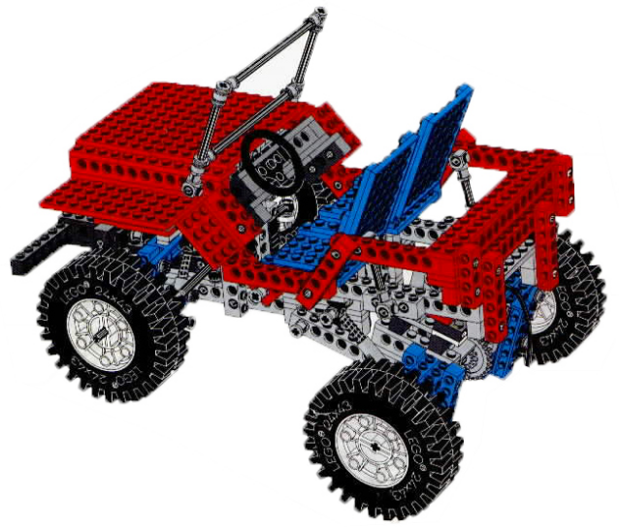
Core + Modules = Site
With the right combination of Core and Modules, you will have a fully functional Drupal website.
Notes:
So what are we actually DOING?
We’re in the process of organizing an event for the end of Janaury.
We’ll give 9 high schools, 10 tickets each to give to interested high school girls. 10 tickets will be reserved for alternatively educated high school girls.
The event will be 2 days, held at Portland State University. There will be about 7 hands on workshops – and we’ll go more detail into those later.
Then, somewhat unique to ChickTech, we plan to have a structure mentoring approach. Instead of having this be a one-off event, we want to ensure that the participants (who showed interest during the workshops) remain engaged. To do this, we’ll meet with the girls every other month to build on what they learned. We’ll do that for 1 year.
And our plan is to have very little “talking at” and more “doing”.
Next we’ll go into details about workshops. At the end we’ll talk about how you can help.

Slide 6
Examples
You can add modules that do things like:
- Rotating banners
- Facebook "like" buttons
- Add streaming video to your site
- Forums
- Sell products with e-commerce
- And about 6000 other things like that
Notes:
So what are we actually DOING?
We’re in the process of organizing an event for the end of Janaury.
We’ll give 9 high schools, 10 tickets each to give to interested high school girls. 10 tickets will be reserved for alternatively educated high school girls.
The event will be 2 days, held at Portland State University. There will be about 7 hands on workshops – and we’ll go more detail into those later.
Then, somewhat unique to ChickTech, we plan to have a structure mentoring approach. Instead of having this be a one-off event, we want to ensure that the participants (who showed interest during the workshops) remain engaged. To do this, we’ll meet with the girls every other month to build on what they learned. We’ll do that for 1 year.
And our plan is to have very little “talking at” and more “doing”.
Next we’ll go into details about workshops. At the end we’ll talk about how you can help.

Slide 7
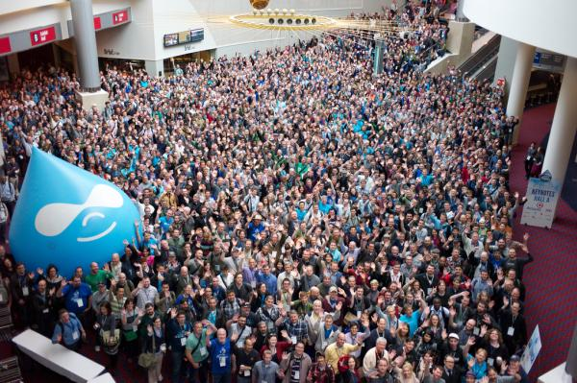

Contrib Modules
8415 just for Drupal 7!
Any one can start a new module, but contrib modules are ones that have been added as projects on drupal.org and have generally been
tested and refined
by the drupal
community.
Notes:
Ok, here’s the list of each of the workshops. We’ll go through each of these a bit. If something sparks your interest or raises suggestions, write it down and we’ll discuss ideas at the end. If something is unclear, feel free to ask and we can try to help answer them.
Later, I’ll give you the status of each of the workshops. For now, we’ll just talk about what the workshops are.

Slide 8

Custom Modules
Odds are if you need it, someone else already has too and a module already exists.
But if not; you can always
make a new one. (unless you're on Drupal Gardens)
Notes:
Ok, here’s the list of each of the workshops. We’ll go through each of these a bit. If something sparks your interest or raises suggestions, write it down and we’ll discuss ideas at the end. If something is unclear, feel free to ask and we can try to help answer them.
Later, I’ll give you the status of each of the workshops. For now, we’ll just talk about what the workshops are.

Slide 9

It can be rough at first
With so many modules out there that do so many things, it can seem overwhelming when you first start with drupal. But the longer you work with more modules, the easier it gets.

Slide 10
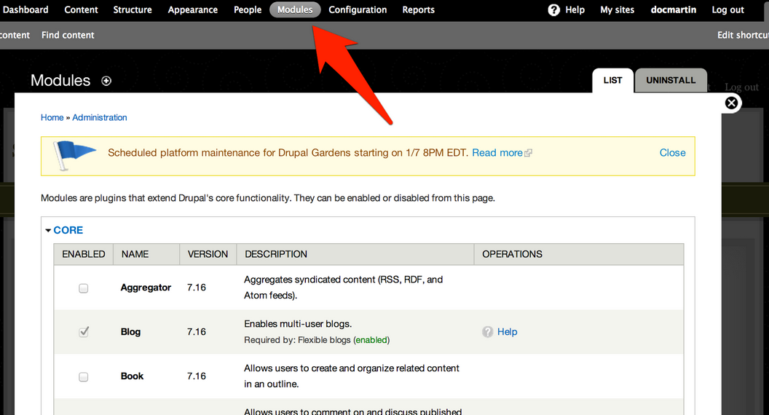
Q: Where are they?
A: In your admin under modules.
Notes:
Ok, here’s the list of each of the workshops. We’ll go through each of these a bit. If something sparks your interest or raises suggestions, write it down and we’ll discuss ideas at the end. If something is unclear, feel free to ask and we can try to help answer them.
Later, I’ll give you the status of each of the workshops. For now, we’ll just talk about what the workshops are.

Slide 11
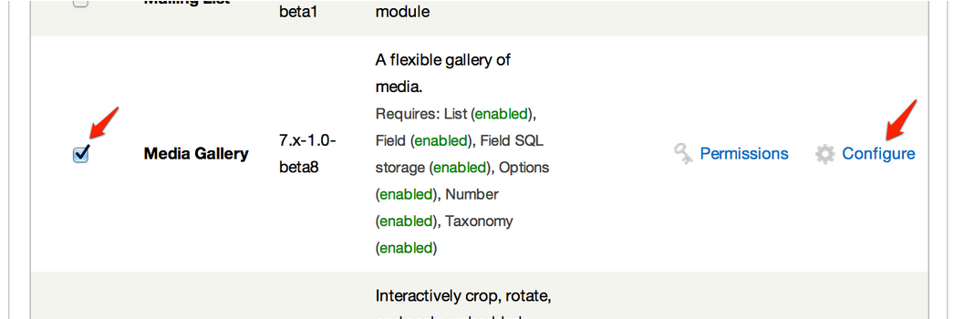
Modules Page
- You can turn modules on and off with the Enable checkbox.
- Some modules allow you to change who can use them with permissions.
- Some modules have their own configuration settings.
Notes:
Ok, here’s the list of each of the workshops. We’ll go through each of these a bit. If something sparks your interest or raises suggestions, write it down and we’ll discuss ideas at the end. If something is unclear, feel free to ask and we can try to help answer them.
Later, I’ll give you the status of each of the workshops. For now, we’ll just talk about what the workshops are.

Slide 12
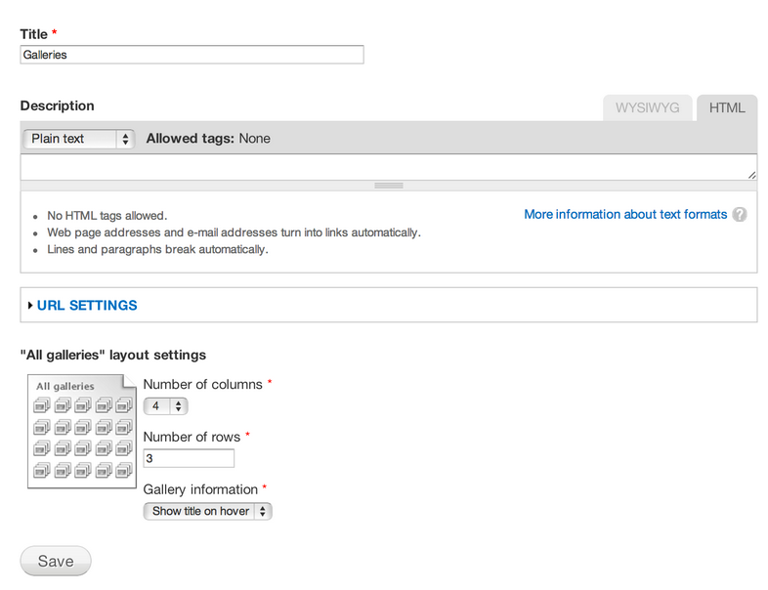
Module Configuration
Options will depend on the module and what it does.
Generally they follow a similar Drupal admin convention.
Settings here are more generalized and change how the module works.
Notes:
Ok, here’s the list of each of the workshops. We’ll go through each of these a bit. If something sparks your interest or raises suggestions, write it down and we’ll discuss ideas at the end. If something is unclear, feel free to ask and we can try to help answer them.
Later, I’ll give you the status of each of the workshops. For now, we’ll just talk about what the workshops are.

Slide 13
Using a Module
- Some modules simply "do their thing" and require little or no interaction on your part.
- Some modules give you entirely new types of content that you can build.
Example: The image gallery module - Allows you to create galleries under the content area of the admin.
- Then you can add images to your gallery.
- And it includes snazzy ways to display those images.
Notes:
Ok, here’s the list of each of the workshops. We’ll go through each of these a bit. If something sparks your interest or raises suggestions, write it down and we’ll discuss ideas at the end. If something is unclear, feel free to ask and we can try to help answer them.
Later, I’ll give you the status of each of the workshops. For now, we’ll just talk about what the workshops are.

Slide 14
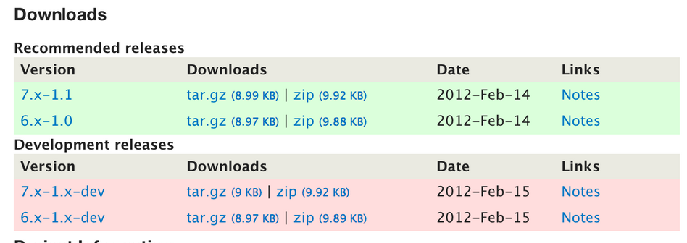
Downloading a Module
- Make sure you get the right version
- The file will be compressed so be ready to unzip or extract the tar file
- Dev releases can be a gamble

Slide 15
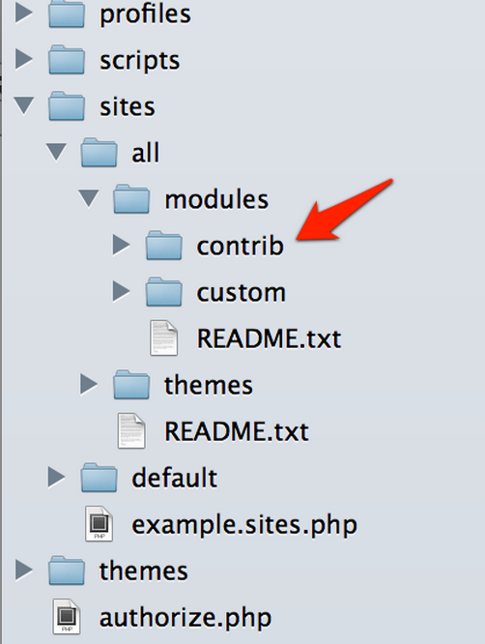
Where to put modules
While modules will technically be found and work in a variety of places, generally you want to put them in sites/all/modules/contrib
&
sites/all/modules/custom You may need to make those folders in a new Drupal installation.
Notes:
Ok, here’s the list of each of the workshops. We’ll go through each of these a bit. If something sparks your interest or raises suggestions, write it down and we’ll discuss ideas at the end. If something is unclear, feel free to ask and we can try to help answer them.
Later, I’ll give you the status of each of the workshops. For now, we’ll just talk about what the workshops are.

Slide 16
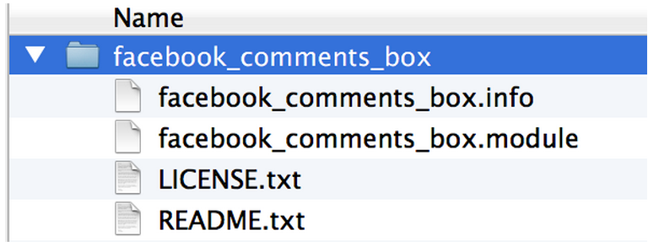
What is in a module
A module must have a .info and a .module file.
Notes:
Ok, here’s the list of each of the workshops. We’ll go through each of these a bit. If something sparks your interest or raises suggestions, write it down and we’ll discuss ideas at the end. If something is unclear, feel free to ask and we can try to help answer them.
Later, I’ll give you the status of each of the workshops. For now, we’ll just talk about what the workshops are.

Slide 17
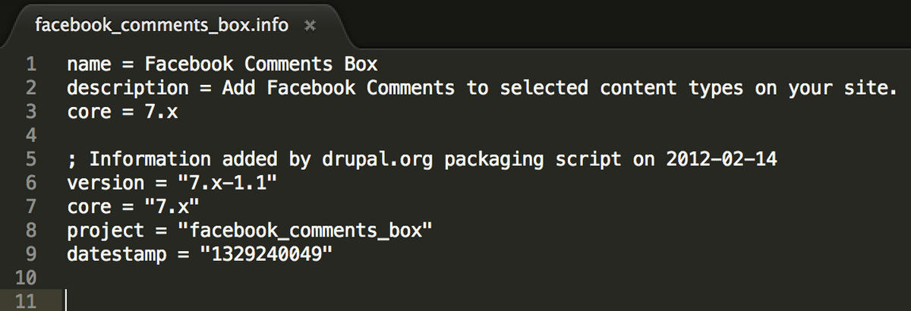
.info Files
A basic file that tells Drupal what the module is, what version it is for, and if it needs any other modules installed to run.
Notes:
Ok, here’s the list of each of the workshops. We’ll go through each of these a bit. If something sparks your interest or raises suggestions, write it down and we’ll discuss ideas at the end. If something is unclear, feel free to ask and we can try to help answer them.
Later, I’ll give you the status of each of the workshops. For now, we’ll just talk about what the workshops are.

Slide 18
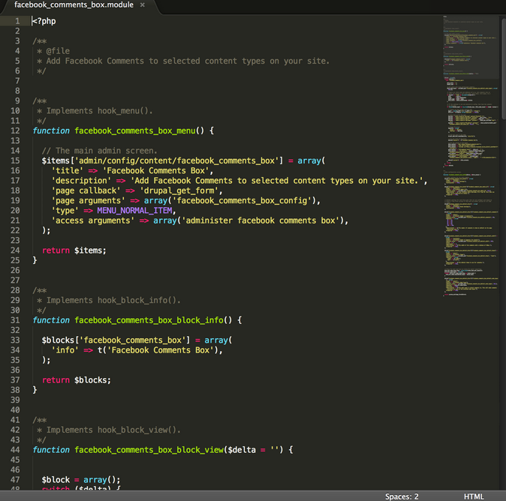
.module File
The php code that actually does stuff.
Notes:
Ok, here’s the list of each of the workshops. We’ll go through each of these a bit. If something sparks your interest or raises suggestions, write it down and we’ll discuss ideas at the end. If something is unclear, feel free to ask and we can try to help answer them.
Later, I’ll give you the status of each of the workshops. For now, we’ll just talk about what the workshops are.

Slide 19
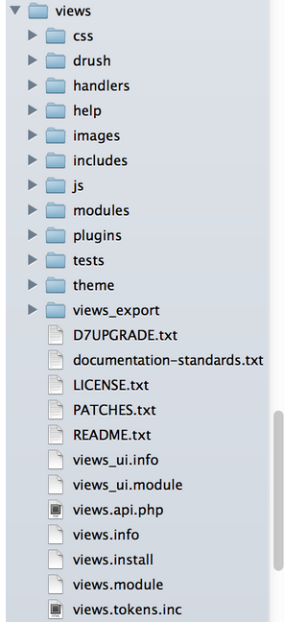
Some modules are "huge"
Some modules are so large that they have many files, and you can even extend those modules with other modules!
As seen by the views module >>>
Notes:
Ok, here’s the list of each of the workshops. We’ll go through each of these a bit. If something sparks your interest or raises suggestions, write it down and we’ll discuss ideas at the end. If something is unclear, feel free to ask and we can try to help answer them.
Later, I’ll give you the status of each of the workshops. For now, we’ll just talk about what the workshops are.

Slide 20
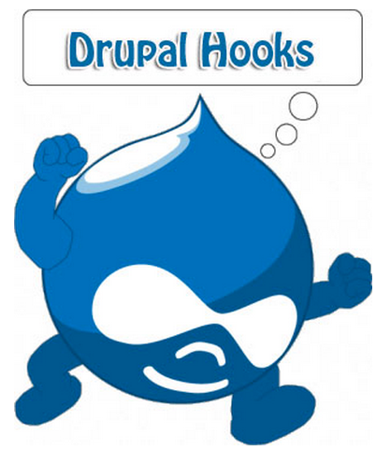
How do they do it? HOOKS!
Hooks are a talk for another day, but in general when a Drupal page displays there are dozens of places that it asks its modules if they want to do anything to the data or page that is loading. A module simply needs to let Drupal know that it wants to use that hook, and do the thing it's there to do.
Hooks are one of the MAJOR concepts that make the Drupal world go around!
Notes:
Ok, here’s the list of each of the workshops. We’ll go through each of these a bit. If something sparks your interest or raises suggestions, write it down and we’ll discuss ideas at the end. If something is unclear, feel free to ask and we can try to help answer them.
Later, I’ll give you the status of each of the workshops. For now, we’ll just talk about what the workshops are.

Slide 21

In Conclusion:
- Modules are awesome.
- Modules make the internet a better place.
Notes:
Ok, here’s the list of each of the workshops. We’ll go through each of these a bit. If something sparks your interest or raises suggestions, write it down and we’ll discuss ideas at the end. If something is unclear, feel free to ask and we can try to help answer them.
Later, I’ll give you the status of each of the workshops. For now, we’ll just talk about what the workshops are.

